Slide 1
Preservation of geometric invariants by Newmark Beta Methods
Utsav Popat

Slide 2
Geometric Numerical Integration
Relatively young field – came into limelight around 40 years ago
Study of numerical solutions to ordinary differential equations had begun in the late 19th Century
But the focus had been on quantity – making the solutions as accurate as possible
Interest in computer simulations over a longer time frame raised an important question

Slide 3
Geometric Numerical Integration
Relatively young field – came into limelight around 40 years ago
Study of numerical solutions to ordinary differential equations had begun in the late 19th Century
But the focus had been on quantity – making the solutions as accurate as possible
Interest in computer simulations over a longer time frame raised an important question
What about the quality of solutions?

Slide 4

Lotka-Volterra Equations
$$\frac{du}{dt}=u−uv, \frac{dv}{dt}=uv−2v$$
where $u\left(t\right)$ is the population of the prey, and $v\left(t\right)$ is the population of the predator
Dividing the two equations,
$$\frac{du}{dv}= \frac{u}{(u−2)}∙\frac{\left(1−v\right)}{v}$$
So,
$$\frac{u−2}{u}du= \frac{1−v}{v} dv$$
and integrating, we get that
$$I\left(u, v\right)=u −2ln{u}+v −\ln{v =const}$$

Slide 5

Lotka-Volterra Equations
Define $a\left(u, v\right) :=u^{′}=u −uv$, $b\left(u, v\right)≔v^{′}=uv −2v$
Explicit Euler
$$u_{n+1}=u_{n}+ha\left(u_{n},{ v}_{n}\right)$$
$$v_{n+1}=v_{n}+hb(u_{n},{ v}_{n})$$
Implicit Euler
$$u_{n+1}=u_{n}+ha\left(u_{n+1},{ v}_{n+1}\right)$$
$$v_{n+1}=v_{n}+hb(u_{n+1},{ v}_{n+1})$$
Symplectic Euler
$$u_{n+1}=u_{n}+ha\left(u_{n+1},{ v}_{n}\right)$$
$$v_{n+1}=v_{n}+hb(u_{n+1},{ v}_{n})$$

Slide 6
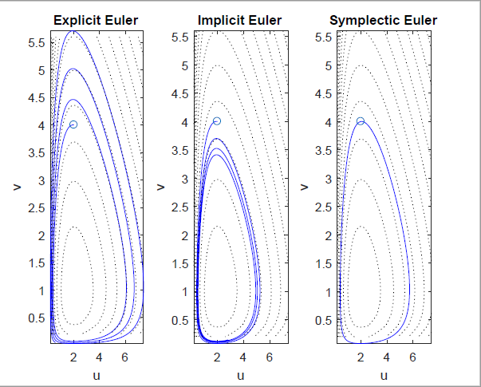


$$\left(u_{0},v_{0}\right)=\left(2, 4\right)$$
$$N=1000$$
$$h=0.02$$

Slide 7
Newmark-Beta Methods

Slide 8
Newmark Beta Methods
$v_{n+1}= v_{n}+h\left[\left(1−γ\right)a_{n}+γa_{n+1}\right]$ $γ ∈\left[0, 1\right]$
$x_{n+1}= x_{n}+hv_{n}+ \frac{h^{2}}{2}\left[\left(1−2β\right)a_{n}+2βa_{n+1}\right]$ $2β ∈\left[0, 1\right]$
Second order accurate if and only if $γ= \frac{1}{2}$
Conditionally stable for $2β≥γ≥ \frac{1}{2}$

Slide 9
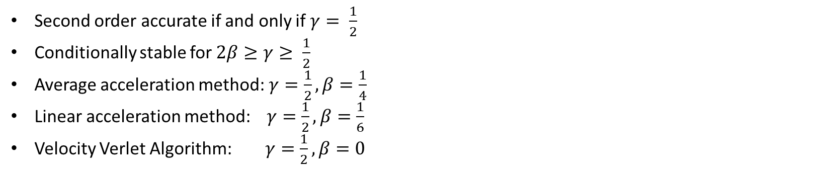
Newmark Beta Methods
$v_{n+1}= v_{n}+h\left[\left(1−γ\right)a_{n}+γa_{n+1}\right]$ $γ ∈\left[0, 1\right]$
$x_{n+1}= x_{n}+hv_{n}+ \frac{h^{2}}{2}\left[\left(1−2β\right)a_{n}+2βa_{n+1}\right]$ $2β ∈\left[0, 1\right]$
Second order accurate if and only if $γ= \frac{1}{2}$
Conditionally stable for $2β≥γ≥ \frac{1}{2}$
Average acceleration method:$γ=\frac{1}{2}, β=\frac{1}{4}$
Linear acceleration method: $γ=\frac{1}{2}, β=\frac{1}{6}$
Velocity Verlet Algorithm: $γ=\frac{1}{2}, β=0$

Slide 10
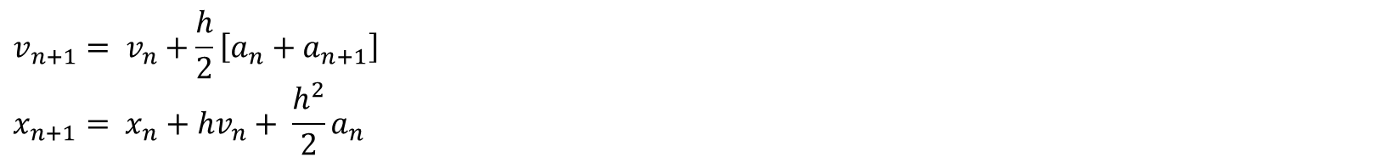
Newmark Beta Methods
$v_{n+1}= v_{n}+h\left[\left(1−γ\right)a_{n}+γa_{n+1}\right]$ $γ ∈\left[0, 1\right]$
$x_{n+1}= x_{n}+hv_{n}+ \frac{h^{2}}{2}\left[\left(1−2β\right)a_{n}+2βa_{n+1}\right]$ $2β ∈\left[0, 1\right]$
Second order accurate if and only if $γ= \frac{1}{2}$
Conditionally stable for $2β≥γ≥ \frac{1}{2}$
Average acceleration method:$γ=\frac{1}{2}, β=\frac{1}{4}$
Linear acceleration method: $γ=\frac{1}{2}, β=\frac{1}{6}$
Velocity Verlet Algorithm: $γ=\frac{1}{2}, β=0$
$$v_{n+1}= v_{n}+\frac{h}{2}\left[a_{n}+a_{n+1}\right]$$
$$x_{n+1}= x_{n}+hv_{n}+ \frac{h^{2}}{2}a_{n}$$

Slide 11
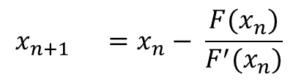

Numerical Representation
$v_{n+1}= v_{n}+h\left[\left(1−γ\right)a_{n}+γa_{n+1}(x_{n+1})\right]$ $γ ∈\left[0, 1\right]$
$x_{n+1}= x_{n}+hv_{n}+ \frac{h^{2}}{2}\left[\left(1−2β\right)a_{n}+2βa_{n+1}(x_{n+1})\right]$ $2β ∈\left[0, 1\right]$
$$F\left(x_{n+1}\right)=x_{n+1} −x_{n} −hv_{n}+ \frac{h^{2}}{2}\left[\left(1−2β\right)a_{n}+2βa_{n+1}(x_{n+1})\right]$$
$$\frac{dF}{dx_{n+1}} =1+{βh}^{2}\frac{da_{n+1}}{dx_{n+1}}$$
$$x_{n+1} =x_{n}− \frac{F(x_{n})}{F^{′}(x_{n})}$$
$$v_{n+1} = v_{n}+h\left[\left(1−γ\right)a_{n}+γa_{n+1}(x_{n+1})\right]$$

Slide 12
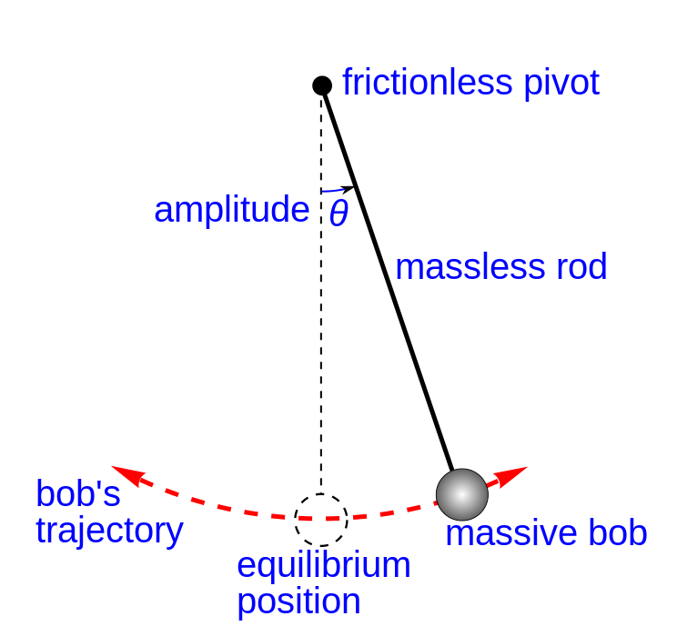


Tests for Convergence
$$\frac{d^{2}θ}{dt^{2}}=−\frac{g}{L}\sin{θ}$$
Initial Conditions:
$θ_{0}=0$
$\frac{dθ}{dt}=5$ rad s⁻¹
$g =10 m \text{s}\text{-}\text{2}$
$L =5 m$
$T=5 s$

Slide 13
Molecular Dynamics

Slide 14
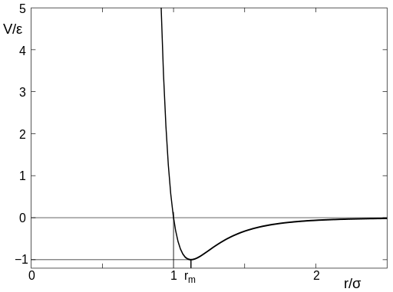

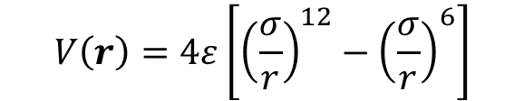
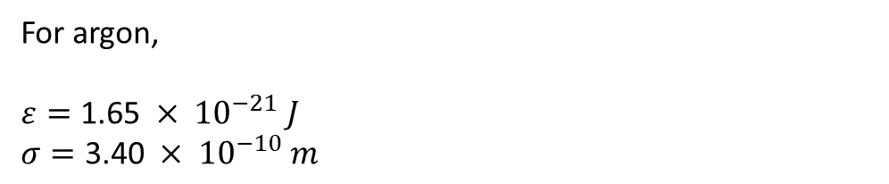
Lennard Jones Potential
$$V\left(r\right)=4ε\left[{\left(\frac{σ}{r}\right)}^{12}−{\left(\frac{σ}{r}\right)}^{6}\right]$$
$$where r= {\left\|r\right\|}_{2}$$
For argon,
$ε=\text{1.65} × {10}^{−21} J$
$σ=\text{3.40} × {10}^{−10} m$

Slide 15

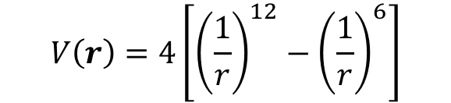
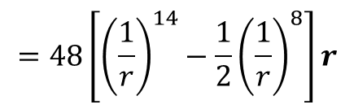

Revised Lennard Jones Potential
$$V\left(r\right)=4\left[{\left(\frac{1}{r}\right)}^{12}−{\left(\frac{1}{r}\right)}^{6}\right]$$
$$where r= {\left\|r\right\|}_{2}$$
$$F\left(r\right)=\frac{−dV}{dr}$$
$$=48\left[{\left(\frac{1}{r}\right)}^{14}−\frac{1}{2}{\left(\frac{1}{r}\right)}^{8}\right]r$$

